Slide 1
Text/Web Search II: Ranking & Crawling

Slide 2
Classical IR Ranking
doc2
doc1
database
justin
Abstraction: Vector space model
We’ll think of every document as a “vector”
Imagine there are 10,000 possible terms
Each document (bag of words) can be represented as an array of 10,000 counts
I.e. a point in 10,000-d space
“similarity” of two documents: “distance” in 10,000d
A query is just a short document
Rank all docs by their distance to the query “doc”!
Note: this is a common/effective trick in AI
Convert your objects to vector space model
Choosing this well is critical!
Use near neighbors to solve problems
bieber
doc3

Slide 3
Cosine Similarity Distance Metric
doc2
doc1
database
Problem 1: two long docs seem more similar to each other than to short docs
Solution: normalize each dimension by vector’s (Euclidean) length
Now every doc is a point on the unit sphere
Corollary: the cosine of the angle between two normalized vectors happens to be their dot product A·B = (x_{A}x_{B}+y_{A}y_{B})!
from law of cosines
Note: for normalized vectors cosine ranking = Euclidean distance ranking
Hence people speak of “cosine similarity” metric rather than “normalized Euclidean similarity”
justin
bieber
doc3
Notes:
|A| = X^2 + Y^2 =
|A|^2 = |A|^2*cos(theta)^2 +

Slide 4
TF × IDF
log damps out idf. What is the idf
of a term that
occurs in all
of the docs?
In only 1 doc?
Simple occurrence counts aren’t good term weights
Want to favor repeated terms in this doc
Want to favor unusual words in this doc
TF × IDF (Term Frequency × Inverse Doc Frequency)
For each doc d
DocTermRank = #occurrences of t in d TF × log((total #docs)/(#docs with this term)) × IDF
Modifies our vector space
Instead of using raw counts (TF) in the vector, use DocTermRank (TF×log(IDF))
And cosine similarity in that space

Slide 5
Indexing TF × IDF
Let’s add some more to our schema
Table TermInfo(term string, numDocs int). (Denominator of IDF)
This is a “materialized” view on the invertedFile table.
(You should write down the SQL for the view)
Table InvertedFile(term string, docID int64, DocTermRank float)
i.e. store TFxIDF with string per doc

Slide 6
TFxIDF for Query Terms
Given a “query doc” like Berkeley Database Research
We can compute DocTermRank for each term quickly:
E.g the DocTermRank for Berkeley:
TF = 1 (by examining the query)
log(IDF): SELECT log(totalDocs/numDocs) FROM TermInfo;
Where totalDocs is the total number of docs in the corpus
Call this Berkeley-querytermrank

Slide 7
In SQL Again…
InvertedFile (term string, docID int64, DocTermRank float)
Simple Boolean Search
CREATE VIEW BooleanResult AS (
SELECT IB.docID, IB.DocTermRank as bTFIDF,
ID.DocTermRank as dTFIDF,
IR.DocTermRank as rTFIDF,
FROM InvertedFile IB, InvertedFile ID, InvertedFile IR
WHERE IB.docID = ID.docID AND ID.docID = IR.docID
AND IB.term = “Berkeley”
AND ID.term = “Database”
AND IR.term = “Research”);
SELECT docID,
(Berkeley-querytermrank>*bTFIDF +
<Database-querytermrank>*dTFIDF +
<Research-querytermrank>*rTFIDF>) AS magic_rank
FROM BooleanResult
ORDER BY magic_rank DESC;
Cosine similarity. Note that the query’s “doc” vector is a constant,
hence the individual querytermranks can be computed before this query

Slide 8
Ranking Query Plan
Sort
Σ_{i} qTermRank_{i}*DocTermRank_{i}
σ_{Berkeley}
σ_{Database}
σ_{Research}
docID | DTRank
42 | 0.361
49 | 0.126
57 | 0.111
docID | DTRank
16 | 0.137
49 | 0.654
57 | 0.321
docID | DTRank
29 | 0.987
49 | 0.876
121 | 0.002
We’ll only rank Boolean results
Note: this is just a heuristic!
There may be “nearby” documents in vector space with different words!
What’s a fix? Is it feasible?
Recall: merge-join the postings-lists from each term, sort by docID
While merging postings lists…
For each docID that matches
Compute cosine distance to query
I.e. For all terms, Sum of product of query-term-rank and DocTermRank
This collapses the view in the previous slide into the query
Notes:
fix: rank matches on subsets of terms.
feasibility: Small # of terms will lead to more docs to rank.

Slide 9
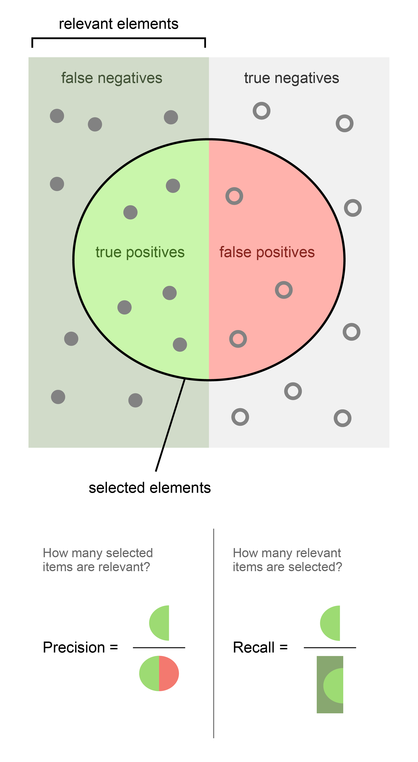
Answer Quality?
Suppose only top k answers are retrieved

Slide 10
Precision and Recall

Slide 11
The remainder of this lecture is just for fun :-)
It will not be tested on any exams.

Slide 12
Parallelizing (!!)
top k
1.
Partition InvertedFile by DocID
Get “top k” or fewer from each node
Partition InvertedFile by term
“Distributed” Join
top k: parallel (or not?)
Pros/cons?
top k
2.
Sort
Join
σ_{Berkeley}
σ_{Database}
σ_{Research}
Notes:
Local joins vs. fully parallel join
Load balancing? Heterogeneous nodes? Easy to manage skew with partition by docID.

Slide 13
Word Occurrence is a Zipf Distribution
George K. Zipf (1949) Human Behavior and the Principle of Least Effort
frequency
log(frequency)
rank
log(rank)
Similar to Pareto Principle
A.k.a. the “80-20” rule: 80% of mass in 20% of terms
“the long tail”
Examples of Power Laws: y = ax^{-k}

Slide 14
Parallelizing Revisited
top k
1.
Partition InvertedFile by DocID
Con: Every query must be broadcast to every node
Not so bad
Partition InvertedFile by term
Con: Hard to balance load, because terms have a Zipfian distribution across docs.
Can be very bad
Hence prefer Scheme #1.
top k
2.
Sort
Join
σ_{Berkeley}
σ_{Database}
σ_{Research}
Notes:
Local joins vs. fully parallel join
Load balancing? Heterogeneous nodes? Easy to manage skew with partition by docID.

Slide 15
Phrase & Proximity Ranking
Sort
Query: “The Who”
How many matches via our previous scheme?
Ranking quality?
One idea: index all 2-word runs in a doc
“bigrams”, can generalize to “n-grams”
give higher rank to bigram matches
More general term proximity matching metrics
how many words/characters apart do terms appear?
add a position field to the inverted index as above
use term proximity to boost overall rank
Σ_{i} qTermRank_{i}*DocTermRank_{i}
Berkeley
Database
docID
DTRank
docID
DTRank
42
0.361
16
0.137
49
0.126
57
0.654
57
0.111
49
0.321

Slide 16
Q-Grams and Spell Fixes
Similar trick works at level of letters
For letters, people tend to say “q-grams” rather than “n-grams”
Create a corpus of correctly-spelled words
Build an inverted index on q-grams of letters
Treat each query word as a search on that corpus
Example
The word “misspelling” is in the index, under each of these trigrams: {mis, iss, ssp, spe, pel, ell, lli, lin, ing}
Query for “mispelling” is converted into this “document” of trigrams: {mis, isp, spe, pel, ell, lli, lin, ing}
The query will find “misspelling” and rank it high via TFxIDF on q-grams!

Slide 17
Some Additional Ranking Tricks
Query expansion, suggestions
Can expand/modify people’s queries if you know “related” terms
Many tricks for doing this, both automatic and human-curated
Document expansion
Can add terms to a doc before inserting into inverted file
E.g. add in “anchor text” of refs to the doc
E.g. classify docs and add tags (e.g. “english”, “japanese”, “adult”)
Not all occurrences are created equal
Mess with DocTermRank based on:
Fonts, position in doc (title, etc.)
Notes:
normalize: “tugs” doc in direction of heavier weighted terms. Because we divide each dimension by overall length,

Slide 18
Hypertext Ranking
On the web, we have more information to exploit than just raw text
The hyperlinks (and their anchor text)
Ideas from Social Network Theory (Citation Analysis)
“Hubs and Authorities” (Clever), “PageRank” (Google)

Slide 19
Intuition for Using Web Graph in Search
From Google’s PageRank (Clever was analogous)
If you are important, and you link to me, then I’m important
Recursive definition --> recursive computation
Everybody starts with weight 1.0
Share your weight among all your outlinks (and yourself, a damping factor)
Repeat (2) until things converge
Note: computes the first eigenvector of the adjacency matrix
And you thought linear algebra was boring :-)
Leaving out some details here …
PageRank sure seems to help
But rumor says: other factors matter as much or more
Anchor text, title/bold text, etc.
Much tweaking over time

Slide 20
Random Notes from the Real World
The web’s dictionary of terms is HUGE. Includes:
numerals: “1”, “2”, “3”, … “987364903”, …
codes: “javac”, “BacktrackingIterator”, …
misspellings: “teh”, “quik”, “browne”, “focs”
multiple languages: “hola”, “bonjour”, “ここんんににちちはは” (Japanese), etc.
Web spam
Try to get top-rated. Seach Engine Optimization (SEO)
Imagine how to spam TF x IDF. The bad old days:
“Stanford Stanford Stanford Stanford Stanford Stanford Stanford Stanford Stanford … Stanford lost The Big Game”
And use white text on a white background :-)
Imagine spamming PageRank…?!
Some “real world” stuff makes life easier
Terms in queries are Zipfian! Can cache answers in memory effectively.
Queries are usually little (1-2 words)
Users don't notice minor inconsistencies in answers
Big challenges in running thousands of machines, 24x7 service!

Slide 21
Building a Crawler
Duh! This is graph traversal.
crawl(URL) {
doc = fetch(URL);
foreach href in doc
crawl(*href);
}
Well yes, but:
better not sit around waiting on each fetch
better run in parallel on many machines
better be “polite”
probably won’t “finish” before the docs change
need a “revisit policy”
all sorts of yucky URL details
dynamic HTML, “spider traps”
different URLs for the same data (mirrors, .. in paths, etc.)

Slide 22
Single-Site Crawler
Multiple outstanding fetches
each with a modest timeout
don't let the remote site choose it!
typically a multithreaded component
but can typically scale to more fetches/machine via a single-threaded “event-driven” approach
A set of pending fetches
this is your crawl “frontier”
can grow to be quite big!
need to manage this wisely to pick next sites to fetch
what traversal would a simple FIFO
queue for fetches give you? Is that good?

Slide 23
Crawl ordering
What do you think?
Breadth first vs. Depth first?
Content driven? What metric would you use?
What are our goals
Find good pages soon (may not finish before restart)
Politeness

Slide 24
Crawl Ordering, cont.
Good to find high PageRank pages, right?
Could prioritize based on knowledge of P.R.
E.g. from earlier crawls
Research sez: breadth-first actually finds high P.R. pages pretty well
Random doesn’t do badly either
Other research ideas to kind of approximate P.R. online
Have to be at the search engines to really know how this is best done
Part of the secret sauce!
Hard to recreate without a big cluster and lots of NW

Slide 25
Scaling up
How do you parallelize a crawler?
Roughly, you need to partition the frontier a la parallel join or map/reduce
Load balancing requires some thought
partition by URL prefix (domain name)? by entire URL?
DNS lookup overhead can be a substantial bottleneck
E.g. the mapping from www.cs.berkeley.edu to 169.229.60.105
Pays to maintain local DNS caches at each node

Slide 26
More on web crawlers?
There is a quite detailed Wikipedia page
Focus on academic research, unfortunately
Still, a lot of this stuff came out of universities
Wisconsin (webcrawler ‘94), Berkeley (inktomi ‘96), Stanford (google ‘99)

Slide 27
Bulk Loading a Web Index
We know how to do this right?
Sort and then bulk load
OK but sort the entire web crawl! Big!
You’d best do it in parallel!
And build partitioned indexes
This task inspired Google to build MapReduce
More on this soon in our lecture on Big Data

Slide 28
Resources
Textbooks
Managing Gigabytes, Witten/Moffat/Bell
Modern Information Retrieval, Baeza-Yates/Ribeiro-Neto
Introduction to Information Retrieval, Manning/Raghavan/Schütze (free online!)
Lecture Notes
Manning/Raghavan/Schütze notes to go with text
Source of some material in these slides

